Slide 1


Battleboards & Cyber War Rooms
Bridging Public Safety & Incident Response

Slide 2

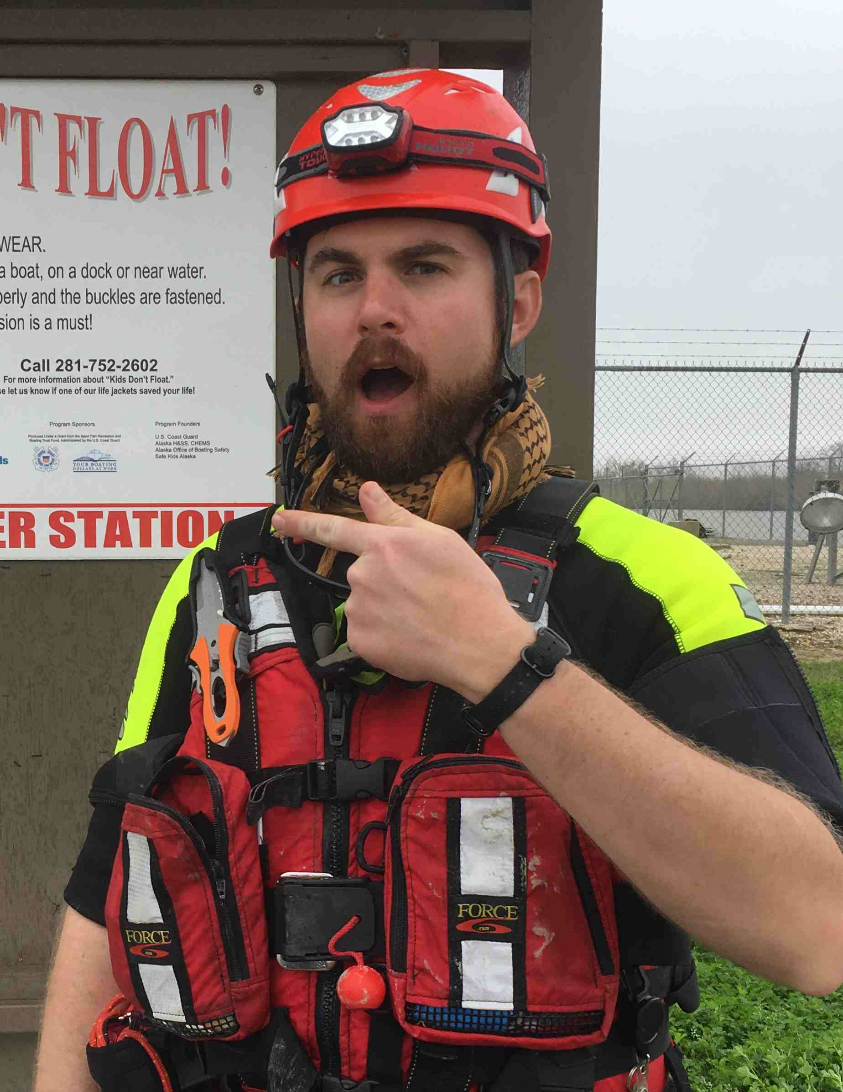
Speaker Introduction:
Kenneth Lindbloom
InfoSec Background
16+ years working in information security in analyst, consultant, and engineering roles with 9 years in the oil & gas sector.. InfoSec generalist with a broad background, recently pivoted to focus on OT security.
Public Safety Background
7 years of search & rescue experience with 6 years of experience as an EMT – including training in wilderness medicine, tactical medicine, and additional work as an event medic. Search & Rescue experience includes ground searches, water rescue, incident management, and high risk EMS operations, with leadership experience.
Education
Bachelor’s In Network Security from UAT
Master’s in Emergency & Disaster Management from AMU
Independent research into medical skill retention & operational medicine.
1st place in APUS’ 2021 Research for the Public Good festival
Notes:
Foot In Two Worlds (professionally & academically)
Cross-disciplinary perspective on IR
Cyber Security
16 years of experience including analyst, engineer, and consultant roles (blue team)
9 years in oil and gas
Recently pivoted to OT cyber security
Bachelor’s in Network Security UAT
Stack of SANS certifications
Public Safety
Volunteer EMT with 7 years of experience in SAR – ground searches, flood & hurricane response, water rescue, high risk EMS
Leadership Experience: Team Lead, COP, Division Lead Medic
Event Medic Work
Firearms Instructor + Church Security
Master’s In Emergency & Disaster Management
Independent research into skill retention & operational medicine
Research into human stress reactions & performance under stress

Slide 3
Contact Info & Slides
Slides on Github
https://github.com/notalotofocelot/Security-Talks
Email
klindbloom@tuta.com
LinkedIn
www.linkedin.com/in/klindbloom
Signal
run2trouble.23
Notes:
Slides will be posted on Github within a week.
Feel free to reach out via email, LinkedIn, Signal, or ask questions after the talk.

Slide 4
Intended Audience
Boots on the ground incident responders, leading from the bottom up.
Security Managers
Executives
Blended IT/OT Cyber IR + Safety + Emergency Management
Notes:
Hands on keyboard incident responder, trying to lead from the bottom on. (will elaborate on that)
Security Managers
Executives
Blended IT/OT + Emergency Management Environments
Could be useful for incident management in the field, but that should really be done in a pre-established Incident Command Center in the cold zone.

Slide 5
Panicky Execs & Overpriced Binders
Notes:
Battleboards
Overpriced binders for very specific use cases
Same results could be, practically speaking, be achieved with a binder purchased from Dollar General
Still worth considering, as way to leverage magical thinking to introduce new organization, training, and Incident Response procedures.
Inspiration for this talk (panicking, micromanaging CIO)
My approach to solving this problem:
Battleboards
Incident Command System
Realistic Exercises

Slide 6
Presentation Overview
Magical Thinking
Human Stress Reactions
What is a Battleboard?
Incident Command System
Training Like You Fight
IR Battleboard Example
Comments on Writing Implements
Summary
Bonus Slide: The Click-Stopping Silver Bullet

Slide 7
Harnessing Magical Thinking
Notes:
What do I mean by this?
Alert Logic Example (checkbox security, IDS under desk)
Firearms community example..
SAR gear acquisition syndrome…
“Military Grade”

Slide 8
Cyber Incident Response
&
Human Stress Reactions
Recommended Reading:
The Unthinkable by Amanda Ripley
The Gift of Fear by Gavin de Becker
Blink by Malcolm Gladwell
The Body Keeps The Score by Bessel van der Kolk
Notes:
You can’t handle an exec or manager the way you would a team mate in search and rescue.
The average manager or executive may not be regularly exposed to high levels of stress
Handling Stress
Some people are naturally more capable by default (Uthinkable special forces example)
Performance under stress can be built
Repeated use of skills and procedures, building muscle memory
Realistic training that introduces stressors
Didactic testing proves nothing.
Memory and performance under optimal conditions may not reflect memory and performance under stress
Recommended Reading

Slide 9
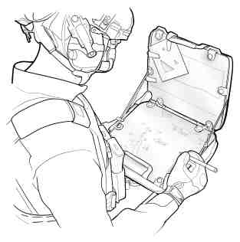
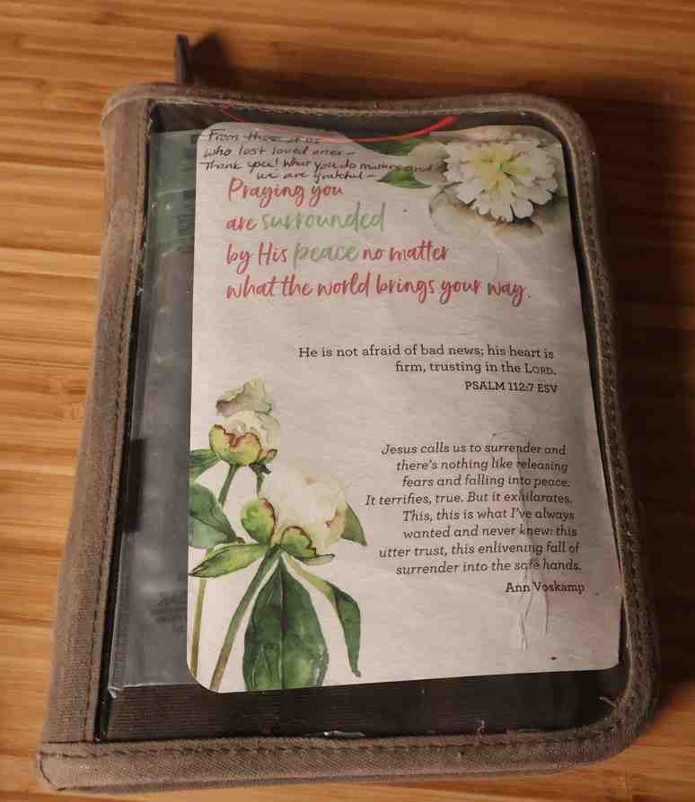
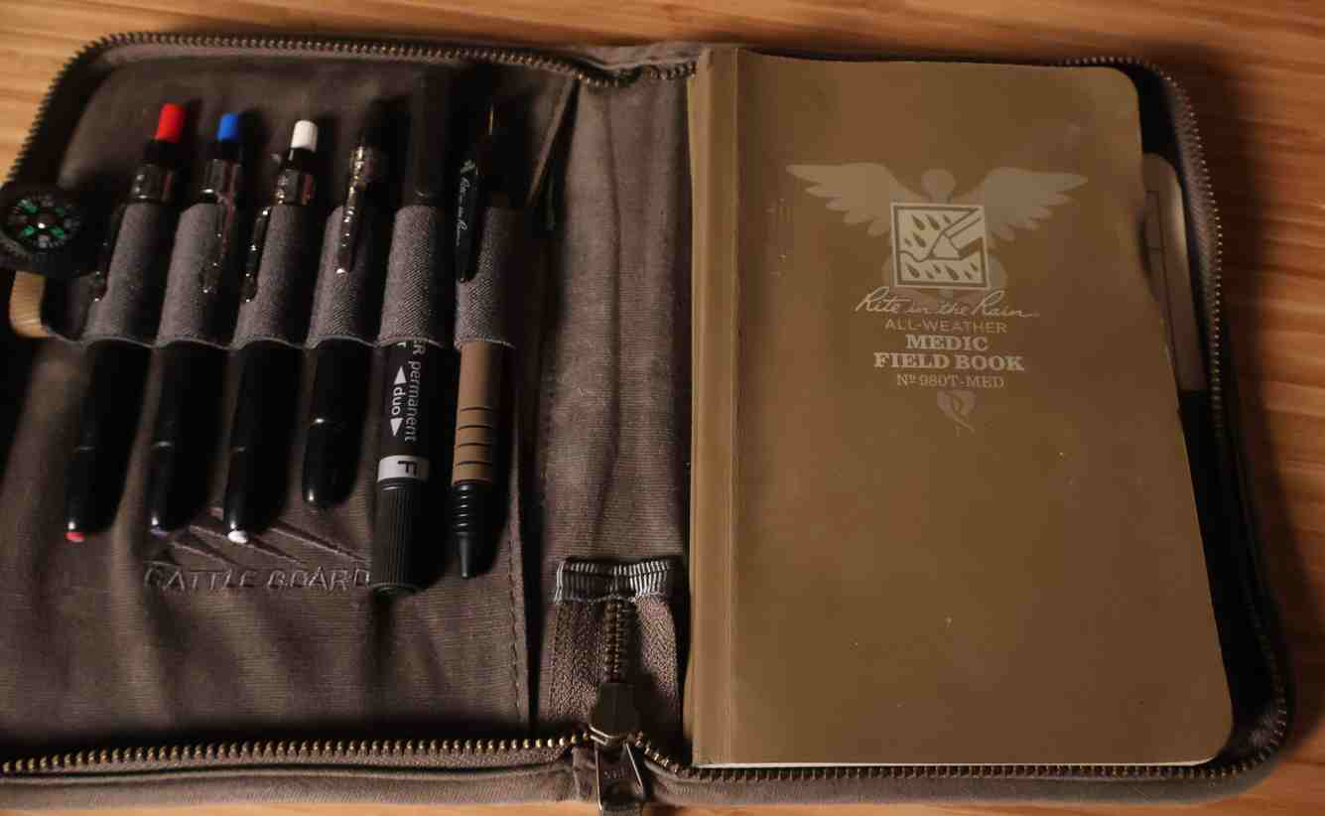
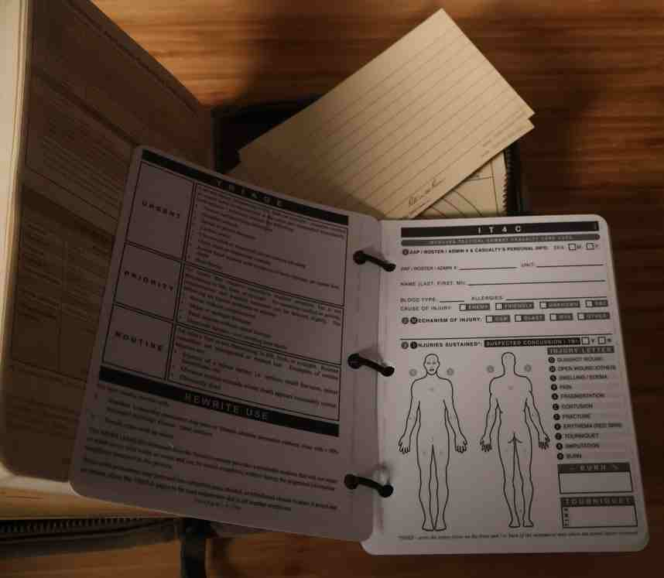
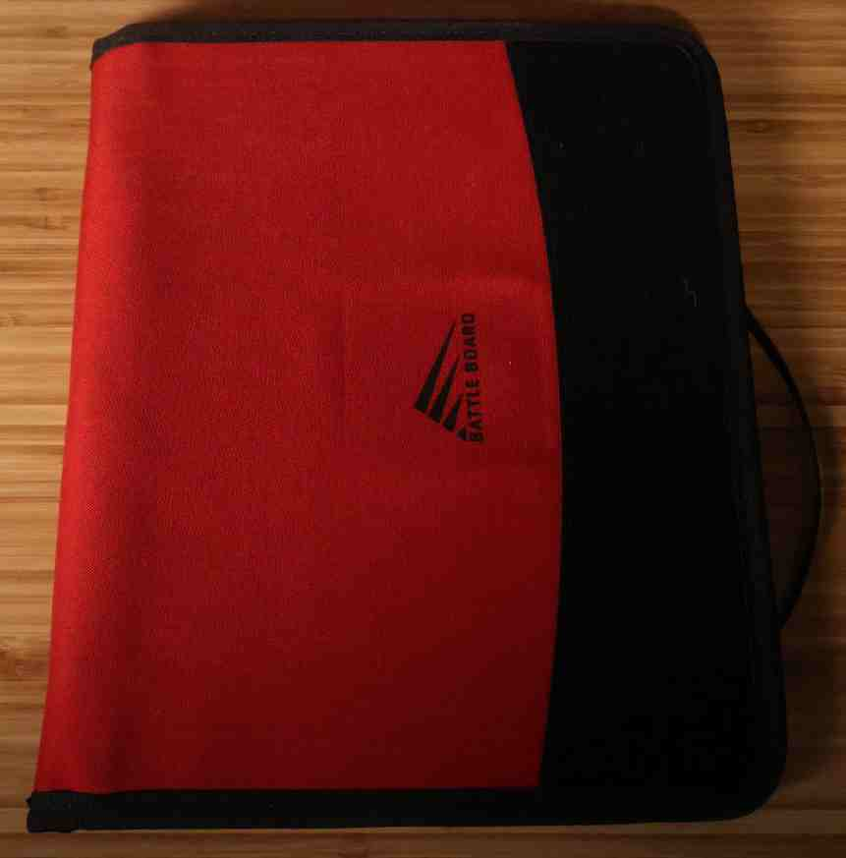
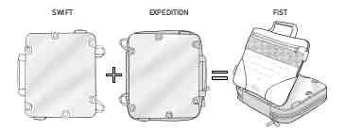
What Are Battleboards?
Notes:
Many varieties for different use cases for disciplines including military, law enforcement, EMS, Search & Rescue
Only one company making products like these that I’m aware of.
Experimenting with them in Search & Rescue
I like the Scout
Examples Here:
Battleboard Scout
FiST 4.0 (Medium)
Fire Support Team (made for coordinating indirect fire)
Field Folder (Large) -cheaper, more similar to your run of the mill binder, but can still leverage magical thinking

Slide 10
Incident Command System
What is it?
Origin
Recommended Classes
IS-100
IS-200
IS-700
IS-800
ICS-300
ICS-400
Community Emergency Response (CERT) Training

Slide 11
Training Like You Fight
Notes:
ICS – everyone knows their role, team stays organized and flexible
Highest rank isn’t IC – it’s first person on scene, then the most qualified
Battleboards - Giving Managers/Exec a job to keep them out of the way (more exciting than calling them a “scribe”)
Keep everything in one central physical location
Develop Muscle Memory with SOPs
Realistic Training
FEMA evaluated exercise
Add stressors
Time
Score
Accountability (get your boss’ boss involved)
Bring in all relevant stakeholders
Conduct exercise off-hours
See who picks up the phone

Slide 12
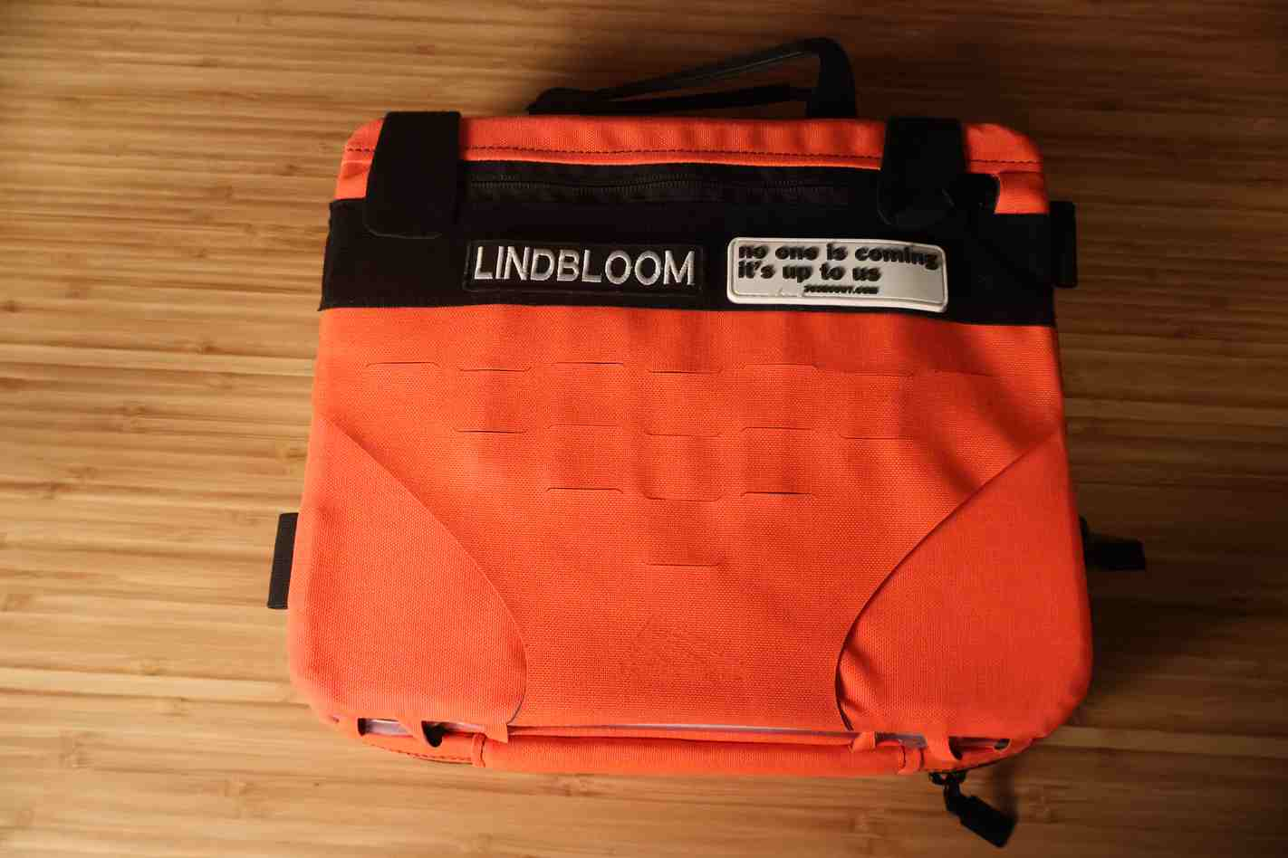
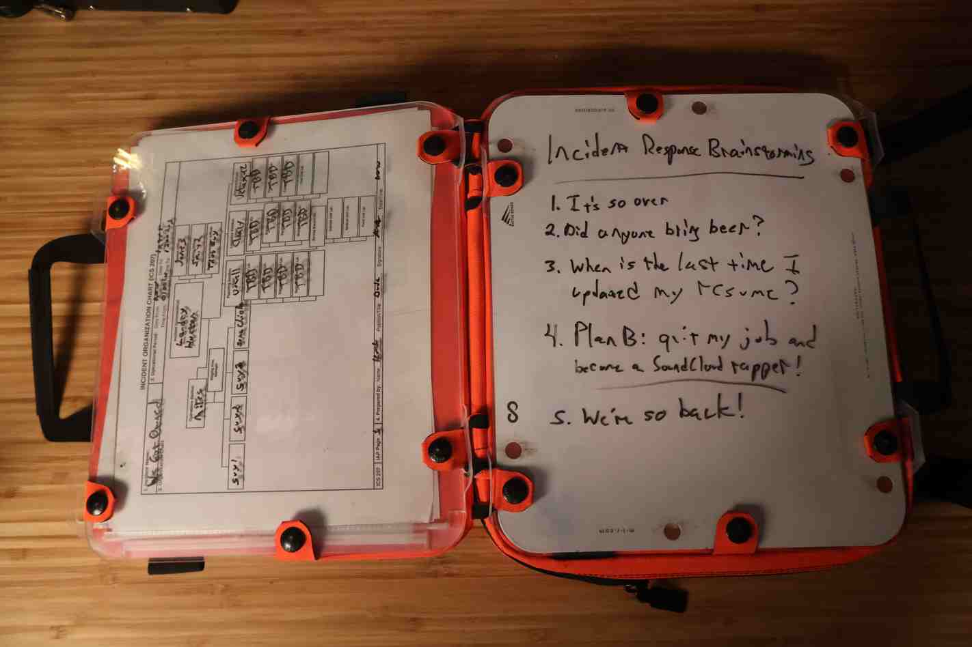
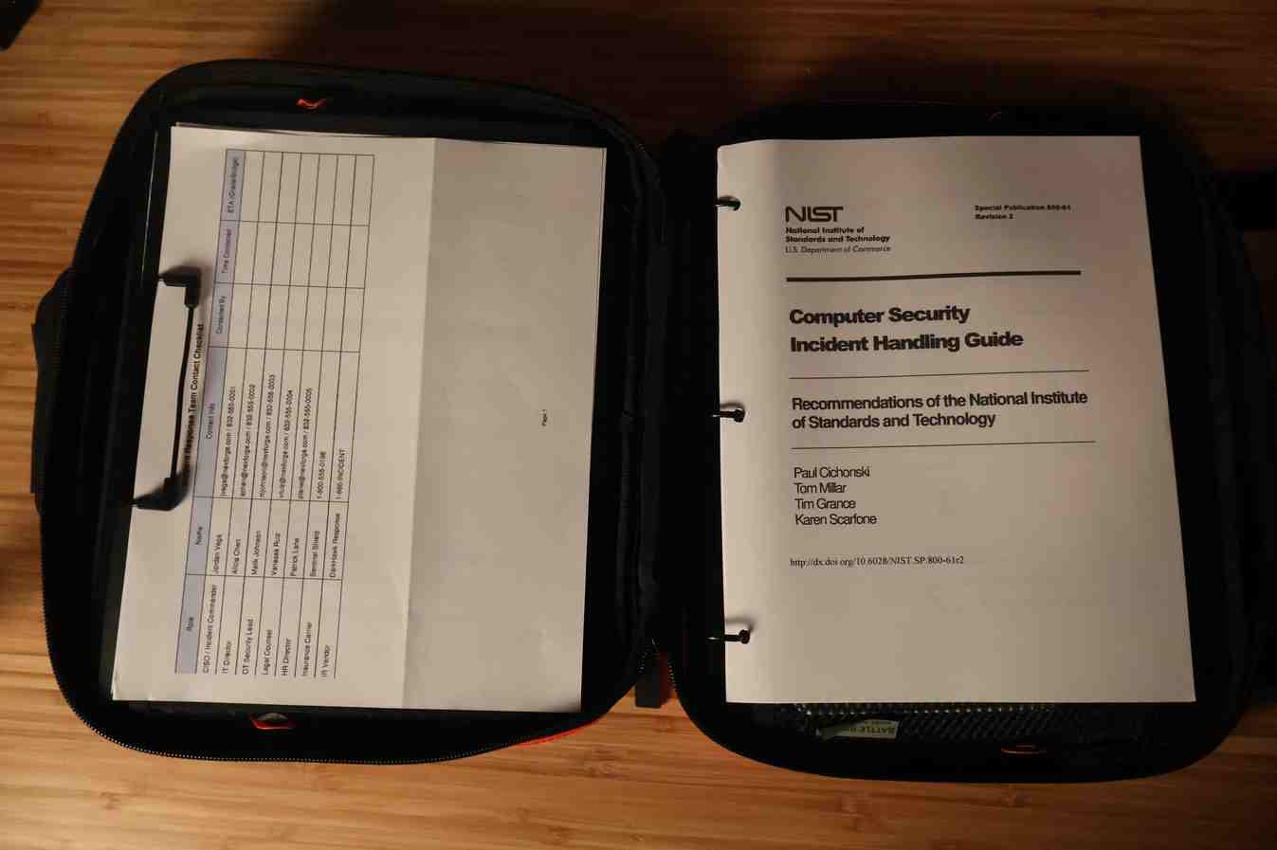
Battleboard Example
Notes:
FiST overview
-two reference or whiteboard surfaces
-interior clipboard and pocket for checklists and reference materials
-3 ring binder with full copy of IR plan
-pocket for USB flash drives with breakglass information, live boot images, whatever
-Notepad for note taking
-lots of room for writing instruments

Slide 13
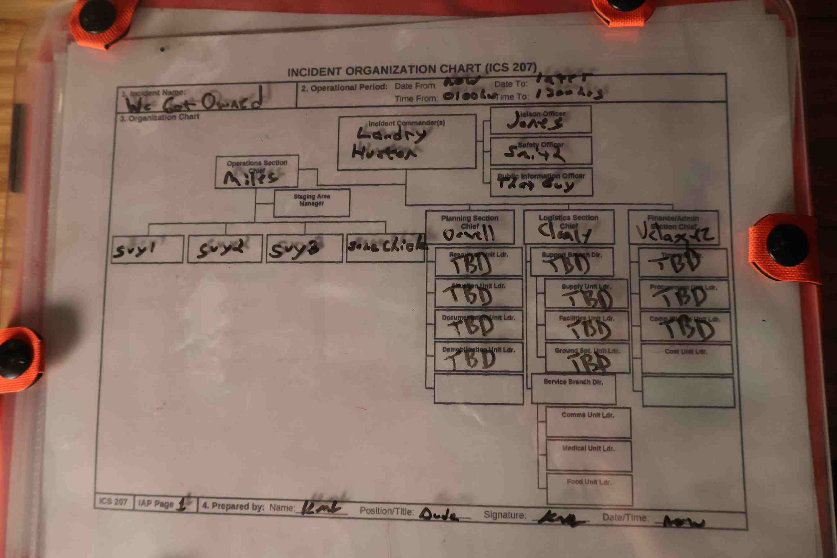
Battleboard Example (cont)
Notes:
Example: Command Structure Dry Erase
-could also keep track of shifts, who’s reporting in

Slide 14
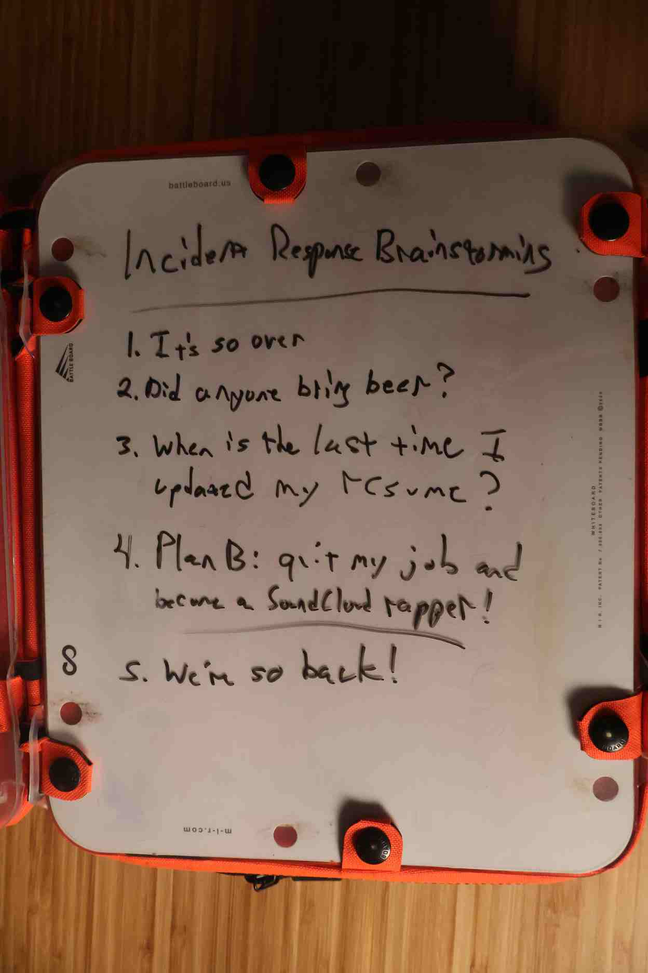
Battleboard Example (cont)
Notes:
Dry erase surfacing for note-taking, collaborating

Slide 15

Battleboard Example (cont)
Notes:
Reference materials and IR plan

Slide 16
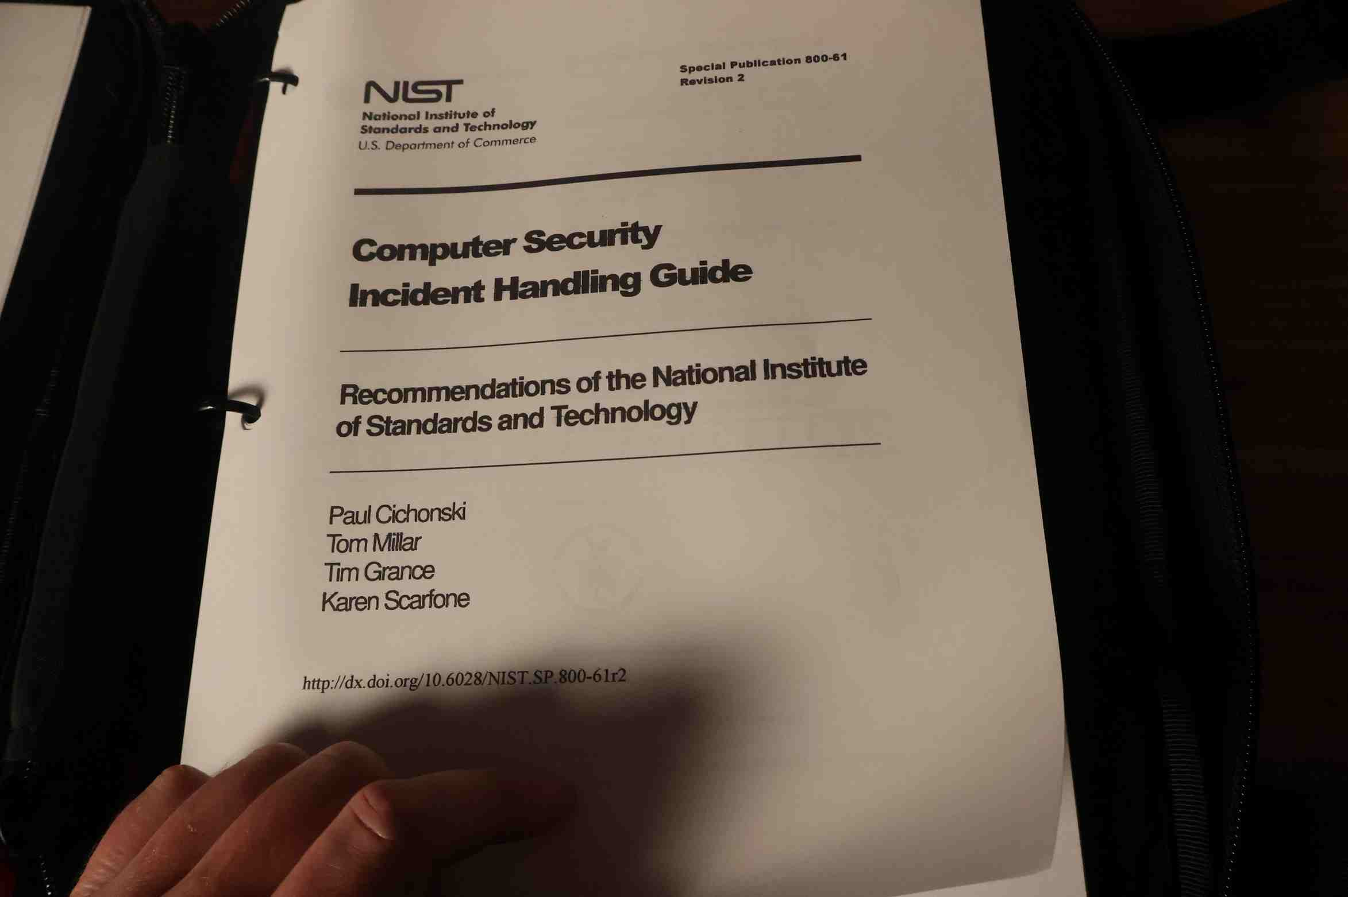
Battleboard Example (cont)

Slide 17
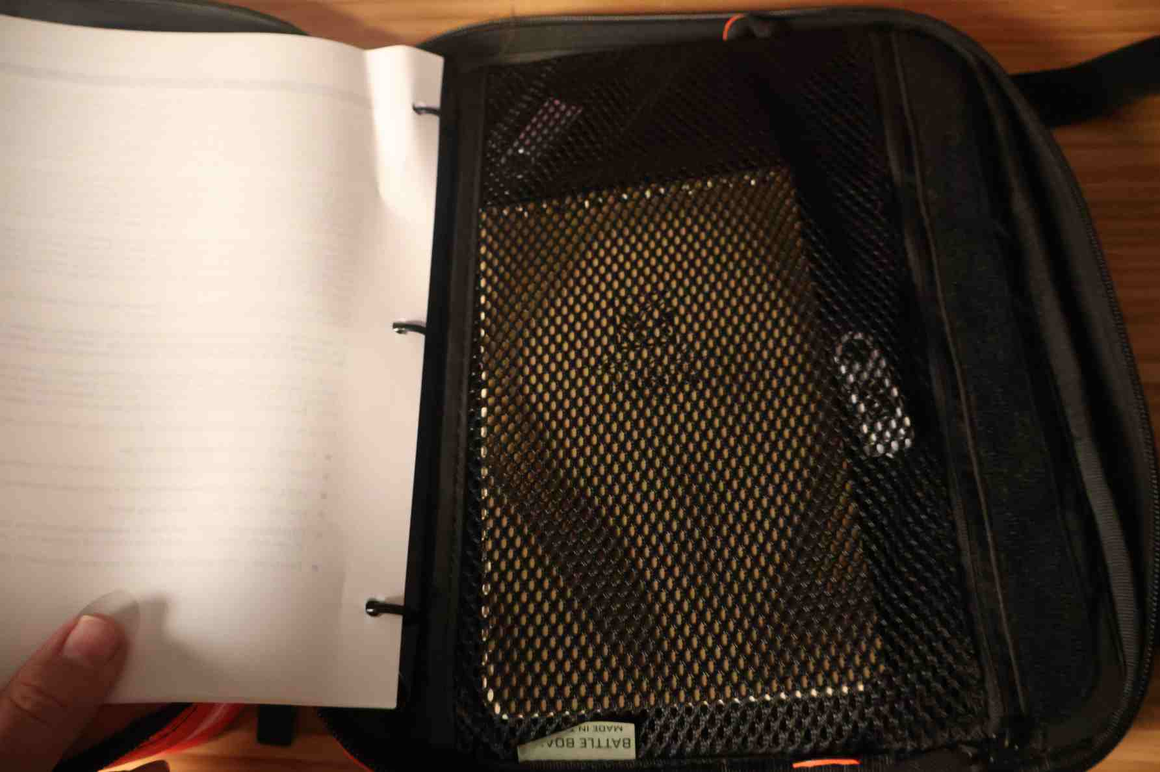
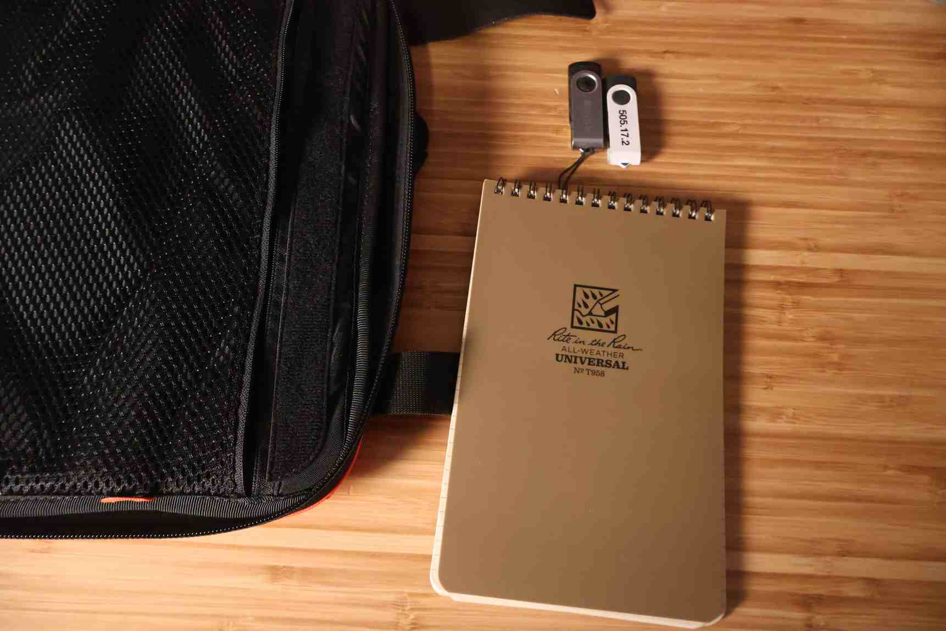
Battleboard Example (cont)

Slide 18
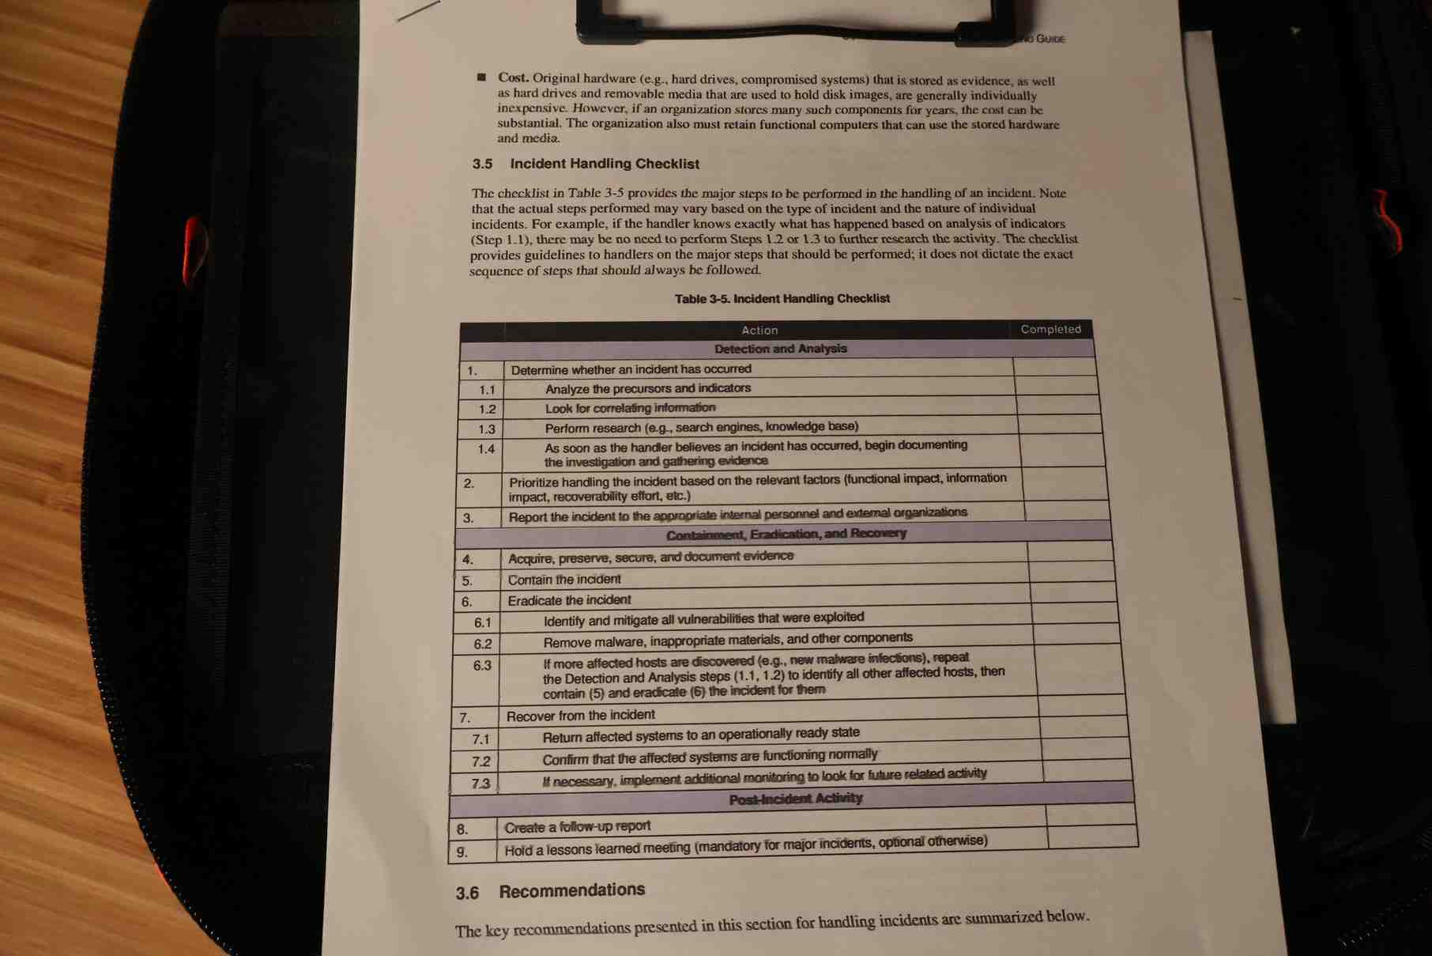
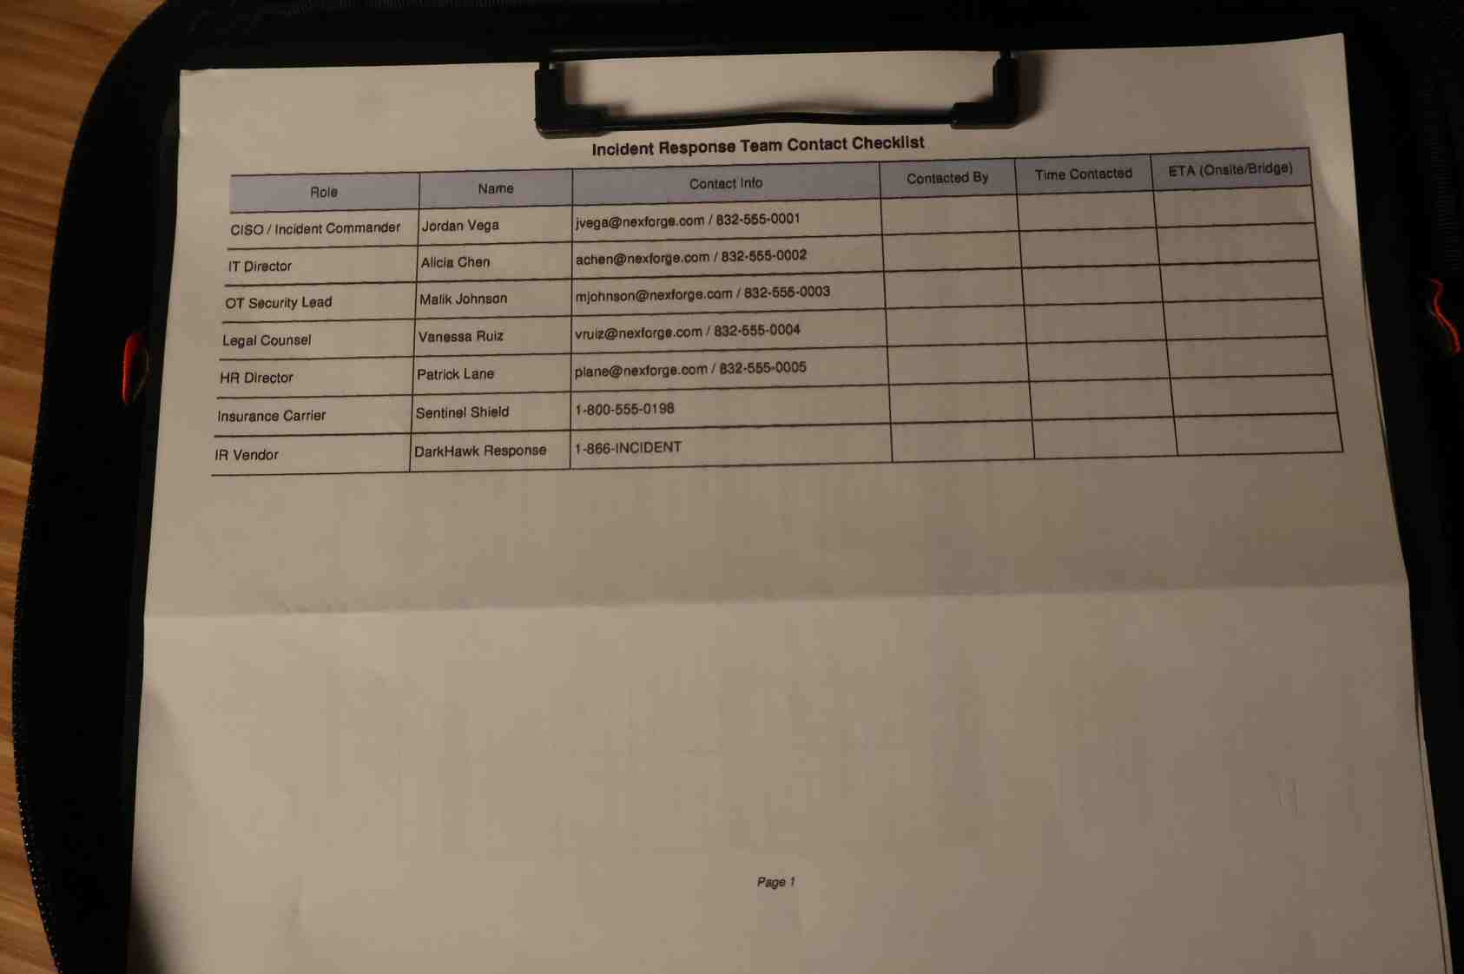
Battleboard Example (cont)

Slide 19
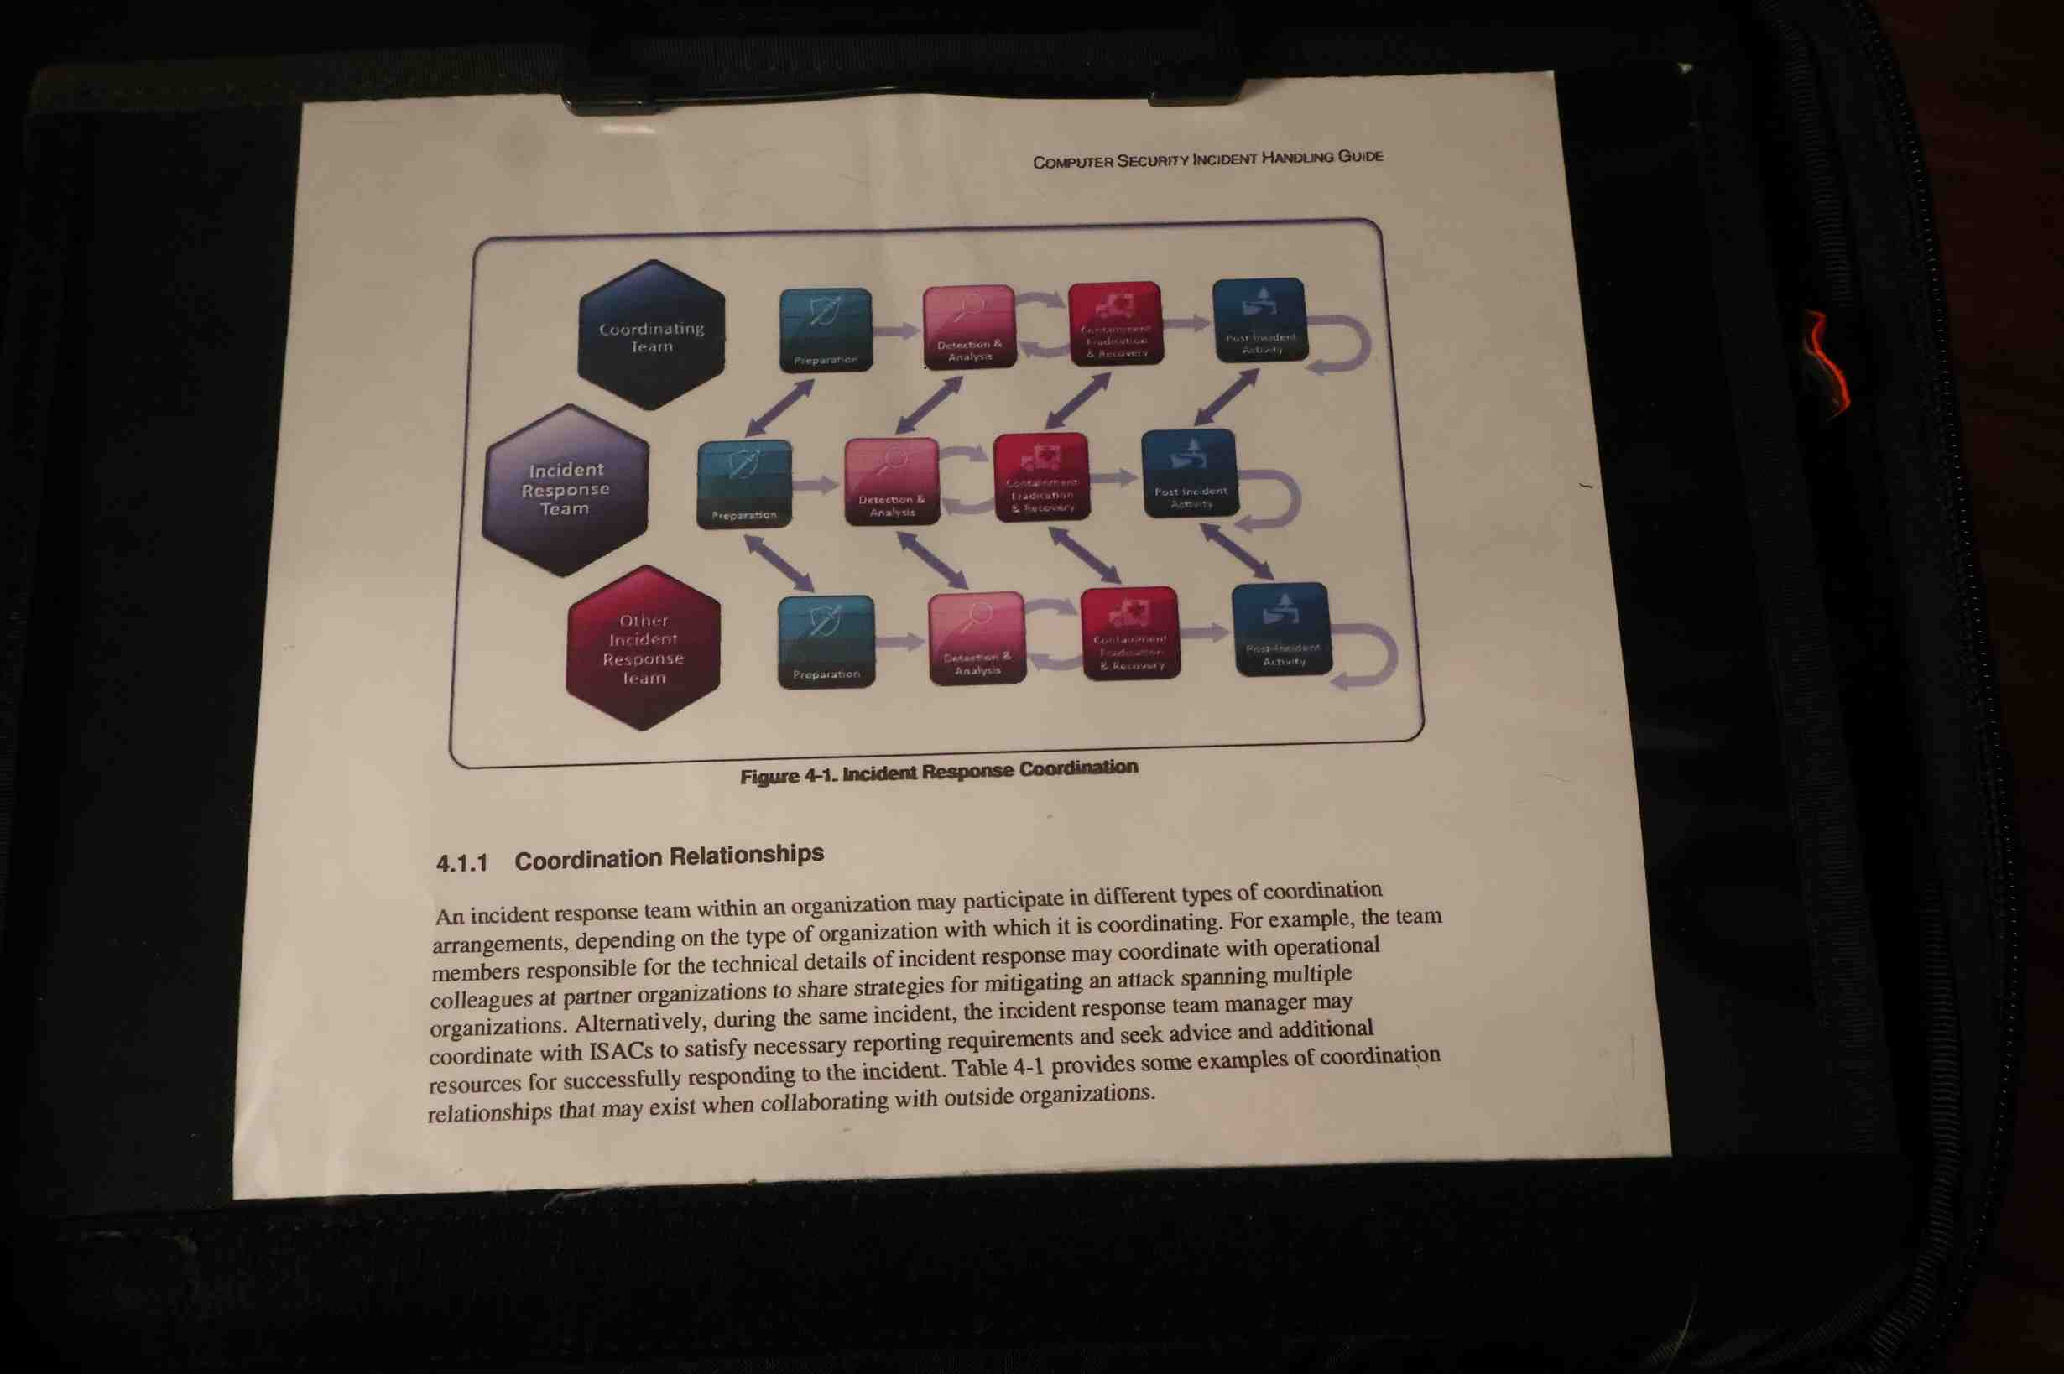
Battleboard Example (cont)

Slide 20
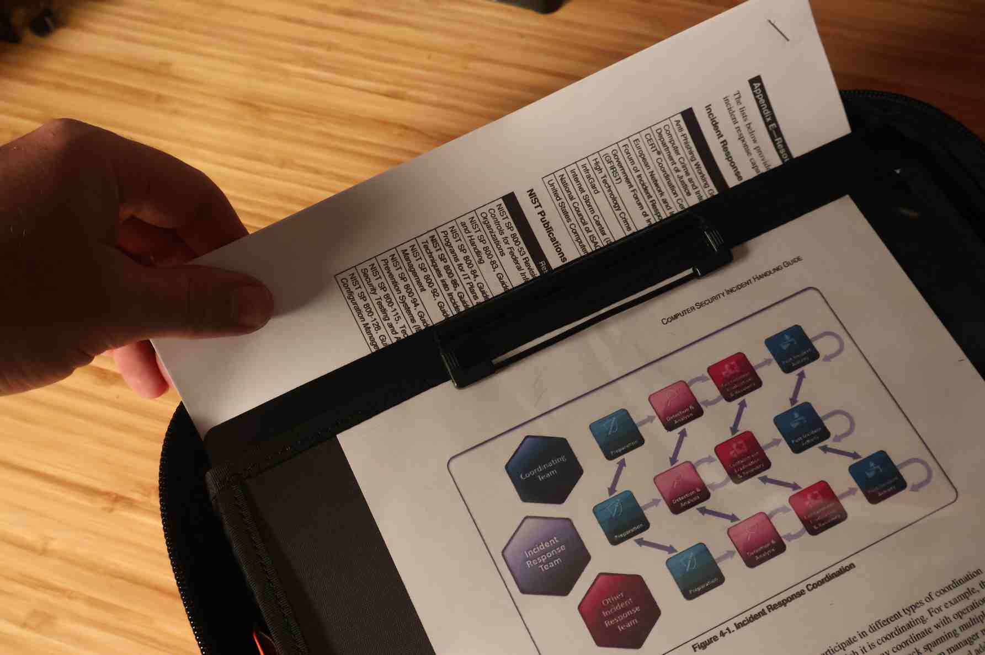
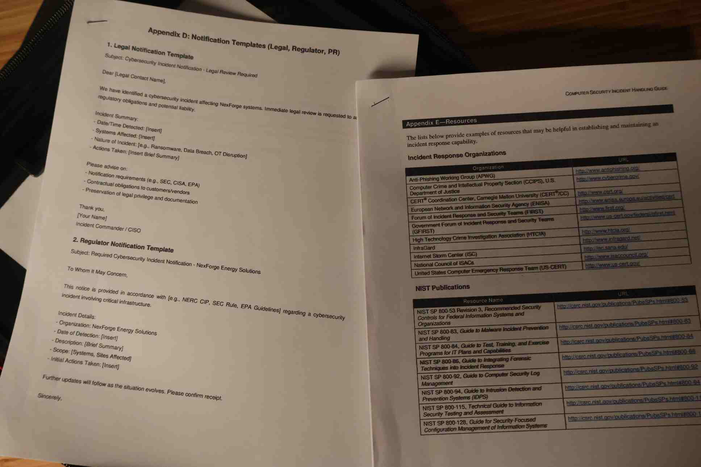
Battleboard Example (cont)

Slide 21
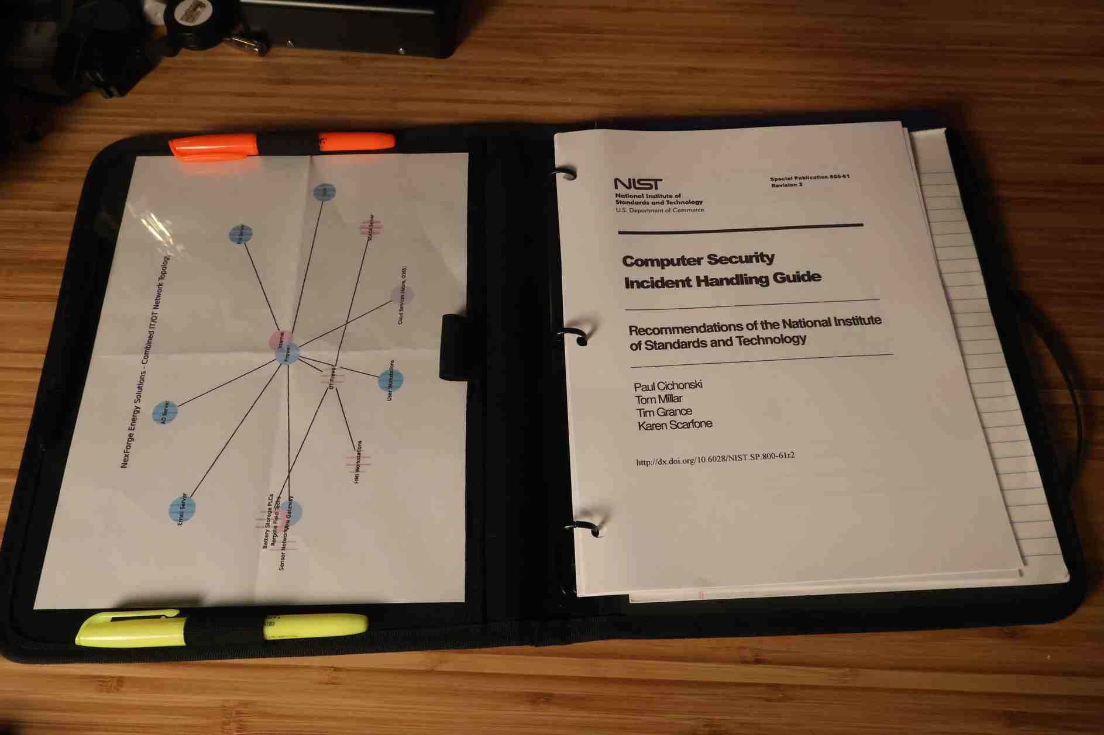
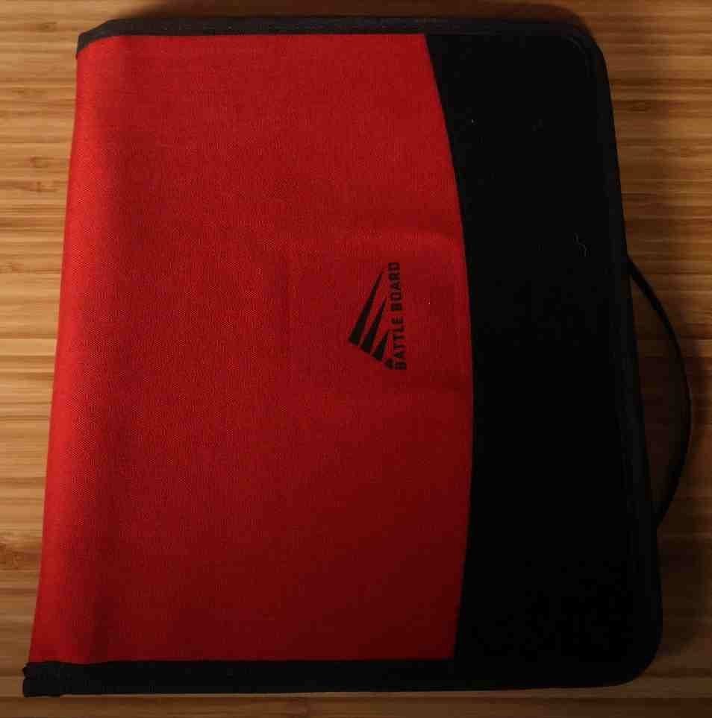
Additional Battleboard Example
Notes:
-Reference material (network topology map)
-IR plan in 3 ring binder
-notepad for notetaking

Slide 22
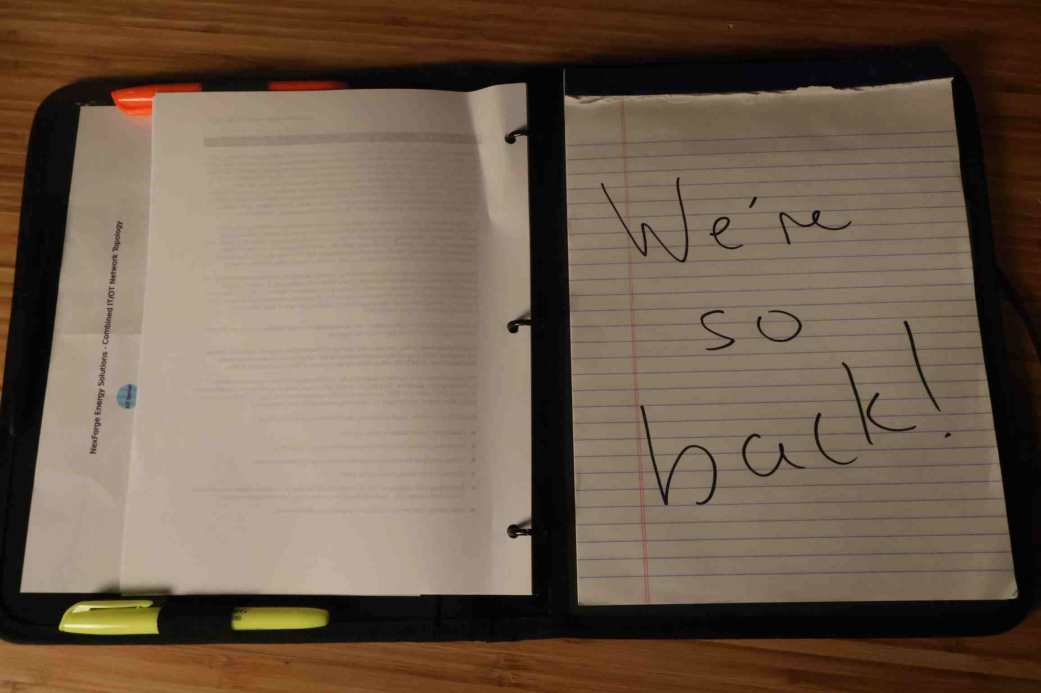
Additional Battleboard Example

Slide 23
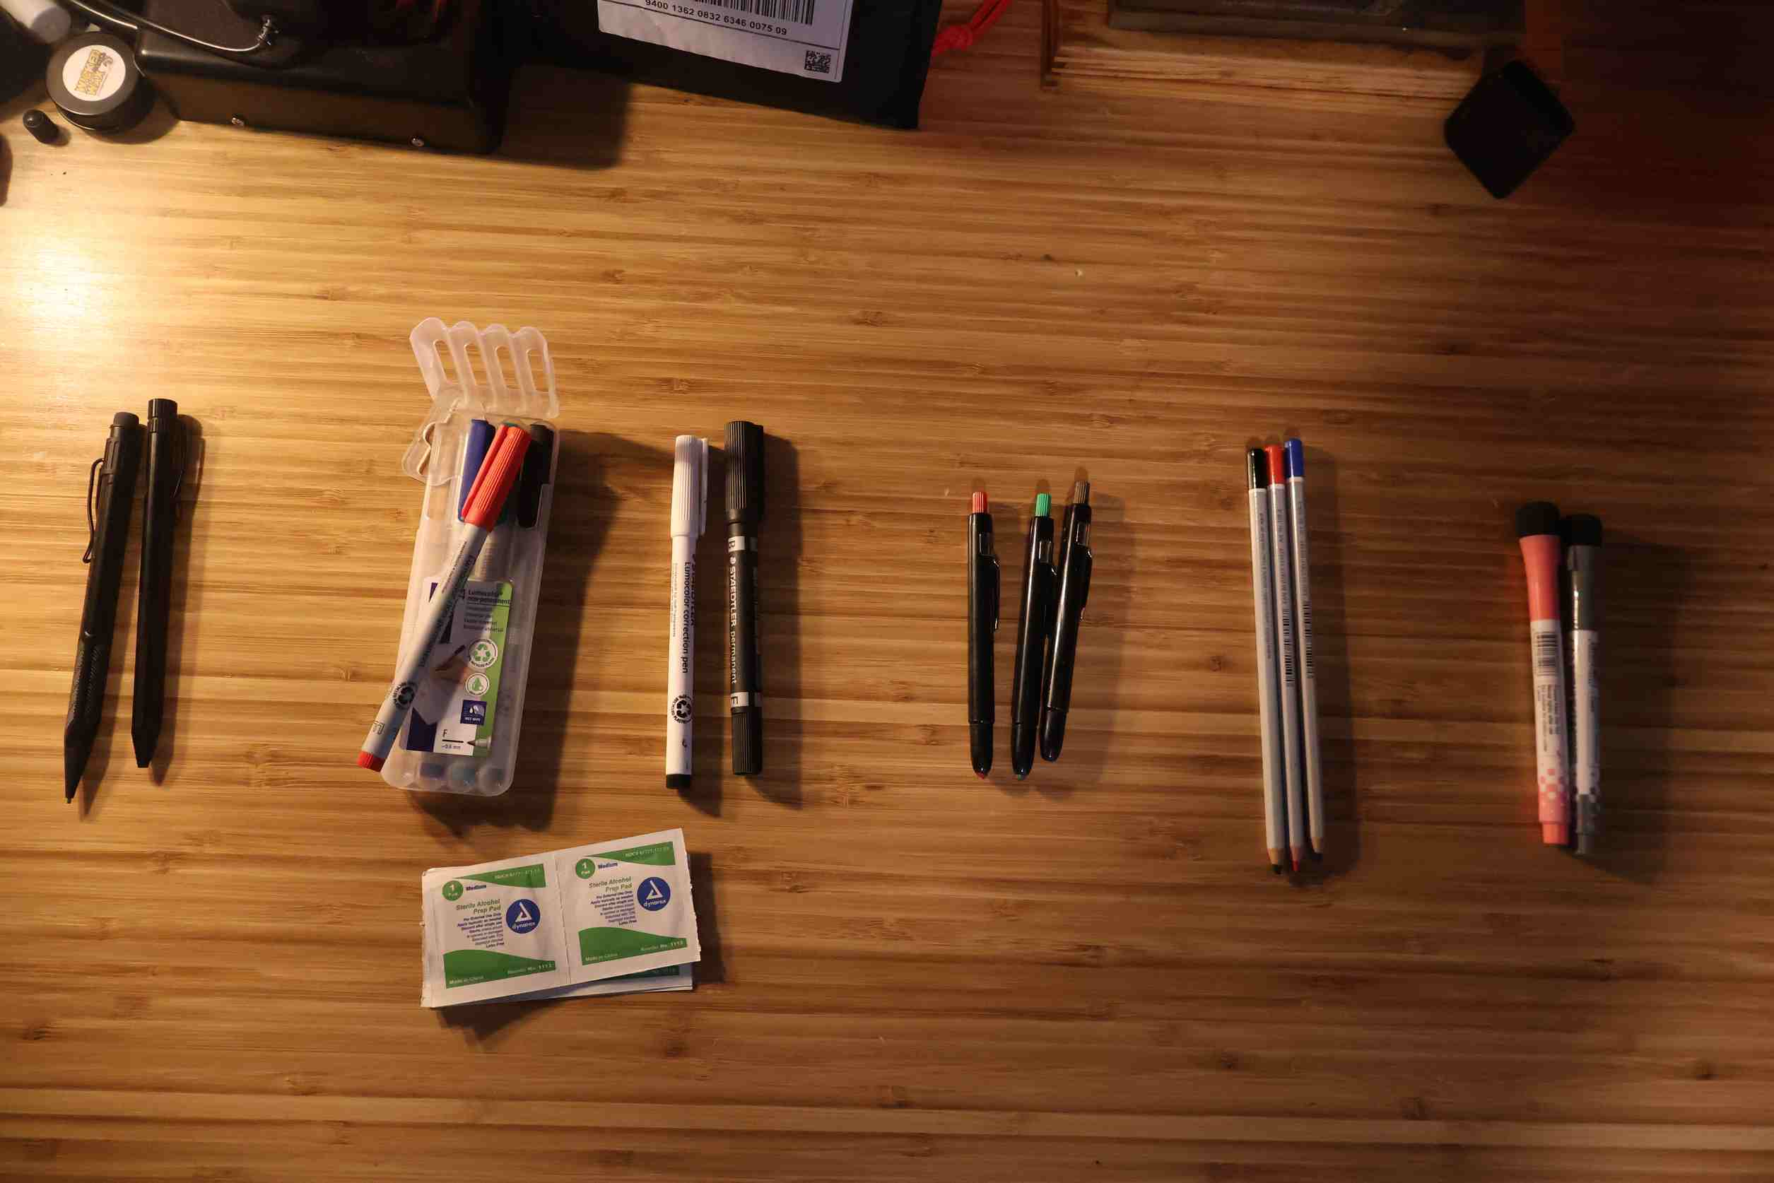
Writing Implements

Slide 24
Summary
Notes:
-develop muscle memory
-develop familiarity with your tools
-giving your execs a job to do and getting them out of the way
-ancillary benefits
-computers go down
-offline copy of documents kept in centalized location
-OT IR with safety implications

Slide 25
Bonus Slide
The silver bullet for getting your users to stop falling for phishing attempts...

Slide 26
Q&A
Notes:
-develop muscle memory
-develop familiarity with your tools
-giving your execs a job to do and getting them out of the way
-ancillary benefits
-computers go down
-offline copy of documents kept in centalized location
-OT IR with safety implications

